Slide 1
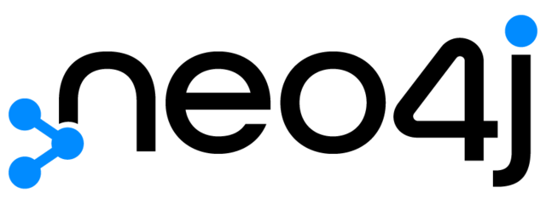
My Understanding of Neo4j
My Career Journey
What can I bring to the table
Abhishek Shankar
03-December-24

Slide 2
My High-Level Understanding of Neo4j:
Neo4j is the leading graph database platform, empowering organizations to harness the power of connected data for solving complex challenges and driving transformative insights.
Areas of Specialization: Graph Databases, Knowledge Graphs, Connected Data Analytics, AI & Machine Learning Integration, and Real-Time Data Insights
Industry Segments: Technology, Healthcare, Supply Chain, Finance, Retail, and Telecommunications
Neo4j’s core values emphasize fostering meaningful relationships, prioritizing user success, embracing an open and inclusive culture, assuming positive intent, encouraging intellectually honest discussions, and delivering on commitments to build trust, drive innovation, and create impactful solutions.
Why Neo4j?
My passion for leveraging graph databases combined with AI/ML to uncover diverse insights is what draws me to Neo4j, an industry leader in the graph database space, and why I applied for this role.

Slide 3






My Journey so Far:
Pursued my undergraduate degree in Mechanical Engineering
Embarked on a journey to bolster my skills in the relam of data science by pursuing a Masters Degree in Information Systems from Northeastern University
Started my journey as a Data Science Intern and progressed into a data analyst – handling cloud infrastructure and product development
Interned as a Data Science Co-op at BI, collaborating with the Central Data Science team to deliver data-driven solutions across the organization.
2015 - 19
2022 - 24
2019 - 22
2023
Foundation
Degree
Data Science
Experience
Academic Experience
Majoring in Data Science
Data Scientist
Experience in the US

Slide 4
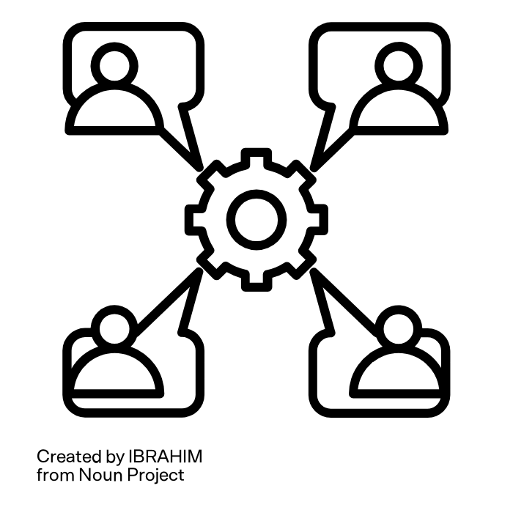
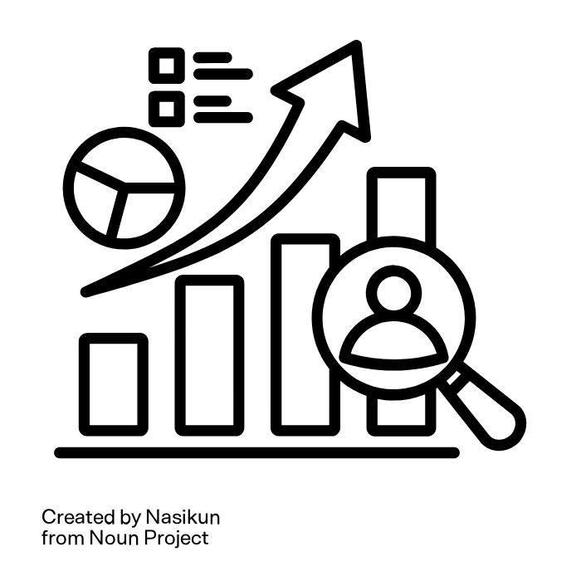
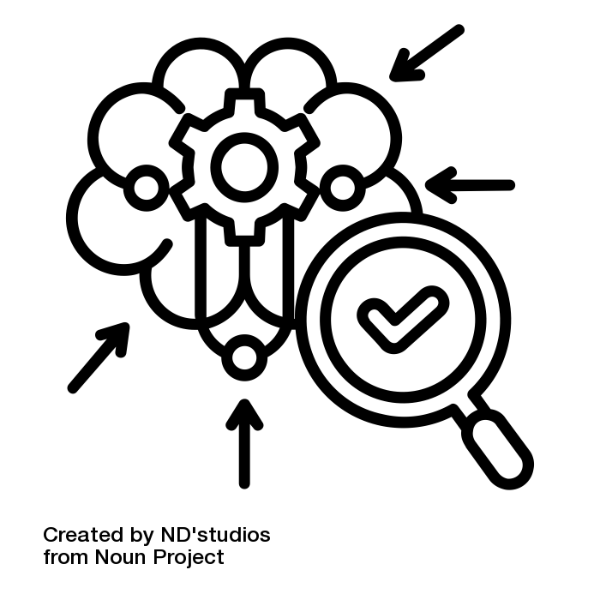

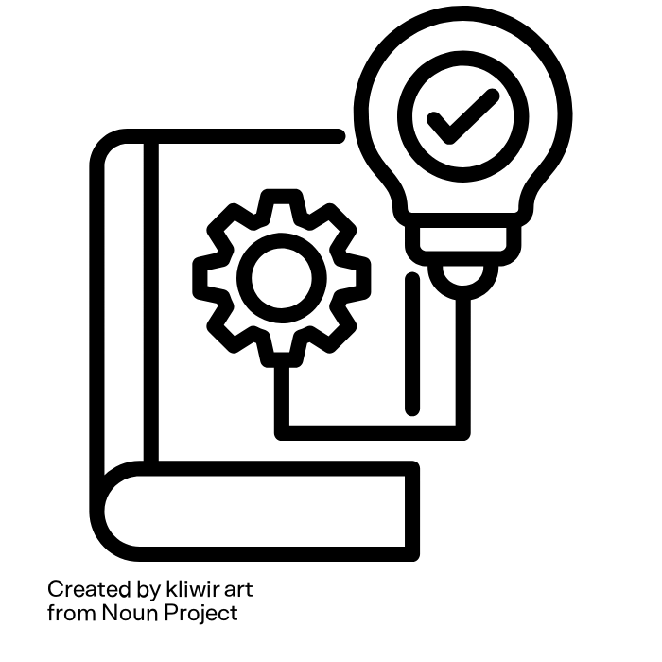
What :I bring to the table:
Data Driven Insights – e.g. transforming complex data into actionable insights for strategic decisions
Technical Proficiency – Proficient in DBMS, Python, and Cloud tools to streamline data processes
Efficiency Optimization – Experienced in identifying and implementing process improvements for operational efficiency.
Cross-Functional Collaboration –
worked closely with GTM, supply chain and product teams
Adept at learning quickly
e.g. learning new technologies and concepts

Slide 5

Plan of Action – First 100 days
Deliver
Learn
Shadow
Stage 1: Training and Familiarization, Documentation and Knowledge Base, Setting Objectives
Stage 2 - Shadowing and Mentorship, On the job learning, and gaining insights into best practices.
Stage 3: Independent Handling of tasks, Continued Learning and Skill Development, Performance Excellence

Slide 6

Thanks for your time
Look forward to the opportunity to work for Neo4j

